Slide 1


Analyzing the Portuguese Bank Case: (Fit the Full and Stepwise Models)
Wake Forest
School of Business
_______
BAN 6025

Slide 2
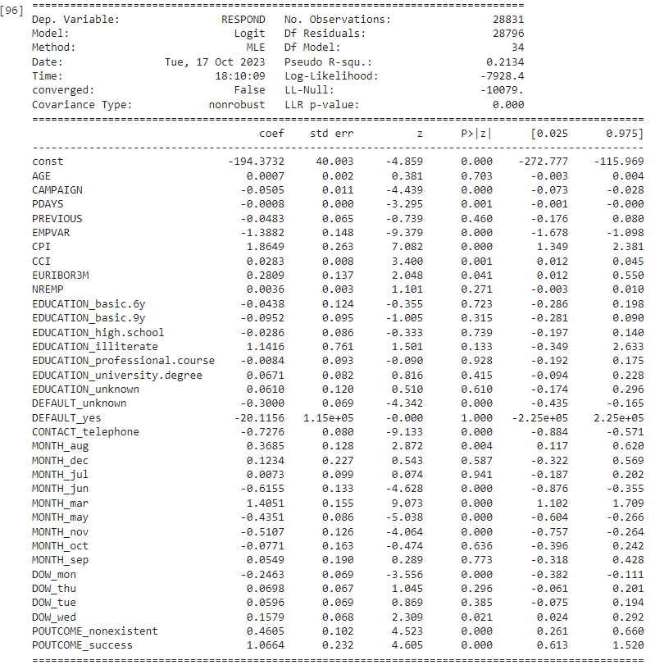
Full Model Results

Slide 3
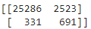
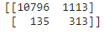
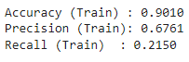
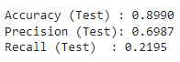
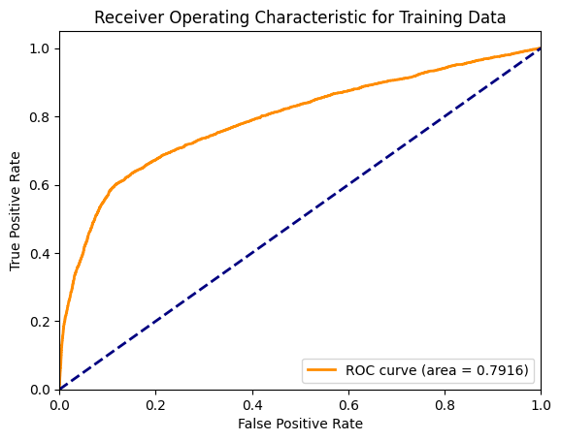
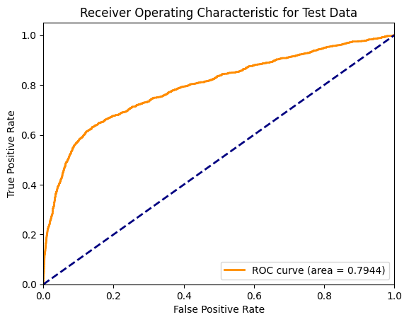
Full Model Assessment
Training Data
Test Data

Slide 4
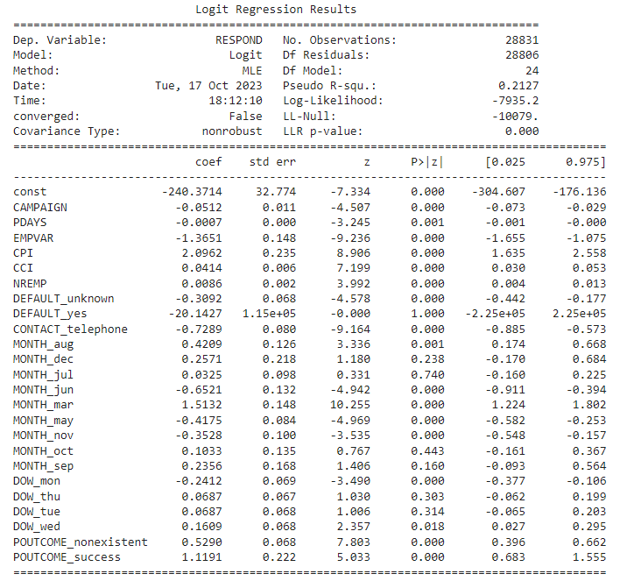
Stepwise Model Results

Slide 5

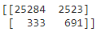
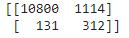
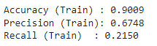
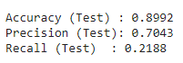
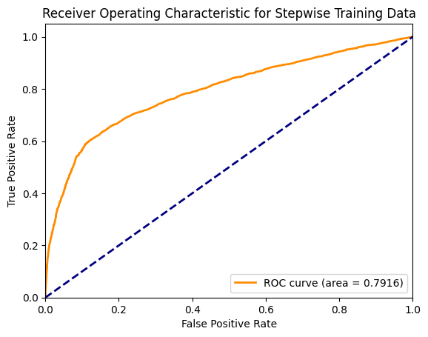
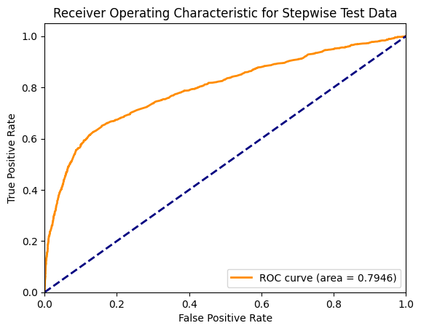
Stepwise Model Assessment
Test Data

Slide 6
Model Comparison
 | Accuracy (Train) | Precision (Train) | Recall (Train) | AUC (Train) | Accuracy (Test) | Precision (Test) | Recall (Test) | AUC (Test)
Full | 0.9010 | 0.6761 | 0.2150 | 0.7916 | 0.8990 | 0.6987 | 0.2195 | 0.7944
Stepwise | 0.9009 | 0.6748 | 0.2150 | 0.7916 | 0.8992 | 0.7043 | 0.2188 | 0.7946

